Slide 1
Shapr3D Take-Home Assignment
Prepared by: Madarasi Nóra Gréta

Slide 2
Content
I. TASK 1
Data Quality
Basic overview
Export rate
Events period
Device platforms
File formats & Resolutions & App version
II. TASK 2
Sessions time analysis
Further Analysis Tips
III. TASK 3
Steps for A/B testing
Hypothetis testing framework
Statistical test

Slide 3
I. TASK 1.

Slide 4
Data Quality
Total rows: 73 008
Total columns: 10 (+ 1 primary key added)
Total duplicates: 44
Workspace_id & Workspace_uuid: majority of them are identical, workspace_id is more likely missing.
Missing values:
event_name | 0.0 %
device_platform | 0.0 %
event_time | 0.0 %
user_id | 0.0 %
active_team_id | 1.15%
app_version | 0.0 %
workspace_id | 62.5%
workspace_uuid | 21.8%
file_format | 78,1%
resolution | 96,7%

Slide 5
Basic overview
Unique designs: 14885 (includes designs that could have multiple events (like exports, opens, etc.) related to them.)
Unique users: 2993
Unique teams: 2941
teamObservation:User behaviour: Usually there is one per team (there are some exceptions), meaning that the engineering designer is working on the product alone and not collaborating in big s.
Events:
Event interpretation
Design Created: Indicates a new project was initiated.
Design Modified (e.g., Renamed): Suggests users are organizing their work.
Design Opened: Reflects that users return to their designs, showing continuous engagement.
Design Exported: Implies users intend to use their designs beyond Shapr3D (e.g., manufacturing, 3D printing, sharing).
design_created | 14,885
design_open_tapped | 37,088
design_name_changed | 50,88
design_exported | 15,945
design_deleted | 2

Slide 6
Export rates
Export rate per total events
(number of exported design divided by number of created design) *100 = 107 %
Explanation: No different users using the same design , either different platforms for the same design, however the final outcome is that one design is exported multiple times (due to updates, revisions, or additional users working with the design.)
Export rate per unique design
One-time export: 2127
Multiple export: 2678
total_multiple_export_value + onetime_export_value) / created_designs *100 = 32%
Explanation: Every third unique created design will end up being exported.

Slide 7
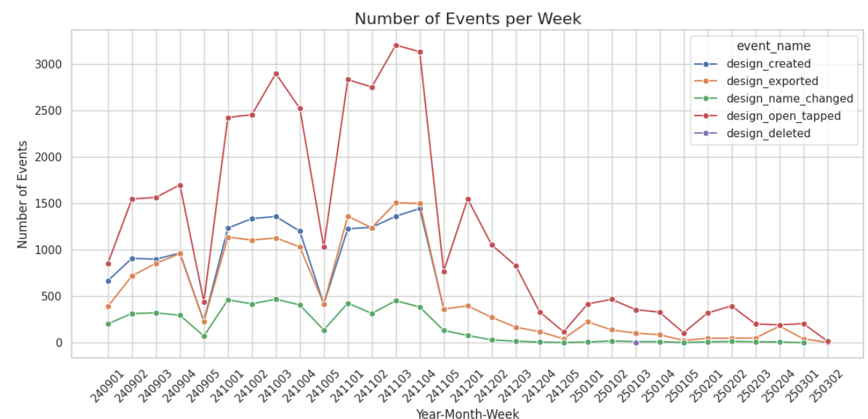
Events period
Observations:
The last design creation was on 2024.11.30, but the dataset also shows further event types also in 2025.
In the last quarter of 2024 (240901 to 241105), the number of events for "Design Created," "Design Exported," and "Design Open Tapped" tends to be higher, especially for "Design Open Tapped" (peak: 3134) and "Design Created (peak: 1508). "

Slide 8
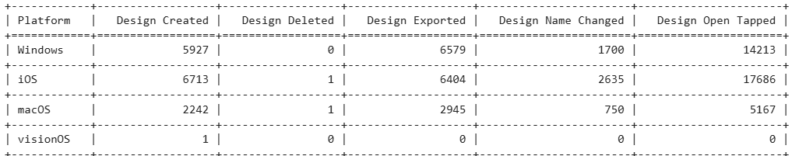
Device platforms
Windows: Has a relatively large number of occurrences across all events. For example, "Design Open Tapped" has 14,213 occurrences.
iOS: Also has a significant number of occurrences, with "Design Open Tapped" having 17,686 occurrences.
macOS: Displays a lower number of events compared to Windows and iOS, but still notable for some events like "Design Created" (2,242).
visionOS: Infignificant
Most fo the design creation and editing/working on the design is on iOS device, but slightly more export in Windows (6579) than on iOS (6404).

Slide 9
File formats & Resolutions & App version
File formats: there are 12 file formats in use, total 15945 values, the most populars are stl (6369), three_mf (4978) and step (2021).
Resolution: total value of 2357: high (1730), low (574), customized (47).
App version: 144 different type of application versions are used, the mostwidely used is the 5.730.0.7613 with 10291 users.

Slide 10
II. TASK 2.

Slide 11
Sessions time analysis
Action steps:
design_event dataset: excluding workspace_uuid <> workspace_id
design_event dataset: putting the workspace_uuid value where the workspace_id is NULL
design_event dataset: putting the workspace_id value where the workspace_uuid is NULL
both datasets: Join tables based on workspace_id for further analysis
Joining the events and session tables: all the workspaces were matched.
Data quality: no duplicates no missing values, but 5598 has value of zero and table also contains sessions where the minutes spent are 1,2,3,4 – very short times spending on sessions.
Therefore it’s not advisable to calculate an average – the outliers can gives us biased results.
Top 3 sessions started per workspace: 45 120, 39 346, 16 458
Top 3 longest time (hours) spent per workspace: 3200, 1260, 1146.

Slide 12
Sessions time analysis
Further Analysis Tips:
User Behavior Insights: To gain a deeper understanding of user behavior, consider comparing the number of sessions with the session hours spent per workspace_id. This will help assess engagement levels
Category-Based Analysis: Create categories for the designed products and perform a deep dive into each category. Filter the data by category and analyze the sessions spent within those categories for more focused insights.

Slide 13
III. TASK 3.

Slide 14
Steps for A/B testing
Data Collection & Background Analysis
Align with Sales, Customer Service, and Complaint Teams to identify key customer concerns post-purchase.
Determine if recurring complaints justify changes to the pricing page.
What % increase of visitors are enough to judge?
What do we consider good enough result in order to implement the changes?
2. Defining Metrics & Duration (Pre-Test Alignment)
Proposed Metrics for Evaluation:
Conversion Rate – % of visitors who sign up or upgrade
with CTA buttons (e.g. Click-Through Rate – Engagement , "Subscribe", "FAQ")
Time Spent on Pricing Page – Measure user engagement
Bounce Rate – % of users who leave without interaction
Duration: Recommended A/B Test Duration: 4 weeks (adjustable based on traffic & baseline data)
3. Content & Page Preparation
Request detailed content updates for the new pricing page from the relevant team and align with IT team on the preparation of the test.

Slide 15
Steps for A/B testing
4. Testing preparation & Data Interpretation
Traffic Segmentation – Ensuring a Fair Test
Compare like-to-like segments:
New vs. returning users
Device type (mobile vs. desktop)
Geographic region (if pricing perceptions vary)
Ensure equal distribution between control & test groups.
Analyze segment-level performance to detect any differing behaviors.
Metric | Statistical test
Conversation rate | Chi-square
CTR | Chi-square
Time on page | T-test
Bounce rate | Chi-square
Assumption checks
Chi-Square Test (for categorical metrics like CTR & conversions)
Independence of observations (each user counted only once)
Expected frequencies ≥ 5 per category (otherwise, use Fisher’s Exact Test)
T-Test (for continuous metrics like time spent on page)
Normality assumption (Shapiro-Wilk test for validation)
Homogeneity of variances (Levene’s test; if violated, use Welch’s t-test)

Slide 16
Hypothesis Testing Framework
Null Hypothesis (H₀): The updated pricing page has no significant impact compared to the current version. Alternative Hypothesis (H₁): The improved pricing page enhances user understanding of the value proposition, leading to higher conversion rates and overall business growth.
Test Parameters:
Significance Level (α): 0.05
Confidence Level: 95%
A/B Test Structure:
Control Group: Sees the current pricing page.
Test Group: Sees the enhanced pricing page with a more detailed feature list.
P-Value Approach for Decision-Making
1. Define Hypotheses: Clearly state H₀ and H₁.
2. Compute the Test Statistic: Use the appropriate statistical test (e.g., Chi-square for conversion rates, t-test for time spent).
3. Determine the P-Value: Measure the probability of observing the data if H₀ were true.
4. Decision Rule: If P ≤ 0.05, reject H₀ (significant difference exists).If P > 0.05, fail to reject H₀ (no significant impact detected).
5. Interpretation & Business Impact: Summarize the findings and recommend next steps.

Slide 17
Statistical test
Chi-squared test
Libraries: Pandas, numpy, scipy.stats : chi2_contingency, ttest_ind
tabulation = np.array([df["Converted"], df["Not_Converted"]])
stats.chi2_contingency(tabulation)
chi2,p,dof,exp = stats.chi2_contingency(tabulation)
print('chi2 :',chi2)
print('p_value:',p)
print('Degree of freedom:',dof)
print('Expected frequency:',exp)
Note: If p-value < 0.05, we conclude that the new page has statistically significant impact on conversion.
Independent t-Test for continous data
Average Time spent on the page on the old and the new page – metric: seconds/minutes.
Libraries: Pandas, numpy, import scipy.stats as stats
t_stat, p_value = stats.ttest_ind(control_time, test_time, equal_var=False).
Note: If p-value < 0.05, the difference is statistically significant, so the users spend more time on the new page.
Group | Control | Test
purchased | 335 | 440
no_purchased | 814 | 795
control_time(mins) | test_time(mins)
5,4 | 8,0
7,1 | 3,1
4,6 | 6,3
… | …

